Slide 1
Graph Databases
Che’ Cobb
Matthew Norton

Slide 2
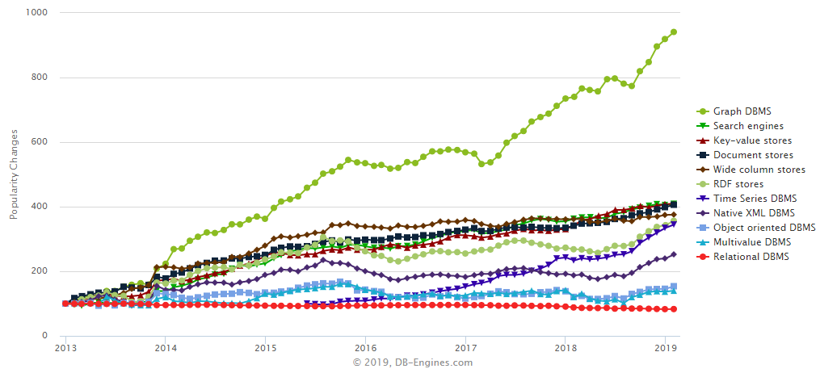
Are Graph Databases the Next Big Thing?
Graph Databases are popular
Well suited for many applications

Slide 3
What are Graph Databases?
A database used to define and portray the relationship between entities.
Entities connected by relationships
Vertices/nodes/points connect with edges/arcs/lines
Shows that the relationship between the data is just as important as the data itself.
A simple DB shows the relation between the objects, but graph database stores the connections with the data
Notes:
Good morning to one and all present here. Today, I am going to present before you one of the hottest technology running now a days. We will be talking about graph databases and NEO4J is one its kind. It is a database used to define and portray the relationship between entities. It shows that the relationship between the data is as important as the data itself. A simple DB shows relation between the objects when run the query, but graph database stores the connections with the data in such a designed model.

Slide 4
What’s Different?
Different from relational
Links are inherent to the datapoints
(employee)-[:REPORTS_TO]->(manager)
Describes relationship in more detail
No nulls
Often more normalized
Simpler queries, especially when complex
No fixed schema, primary or secondary keys

Slide 5
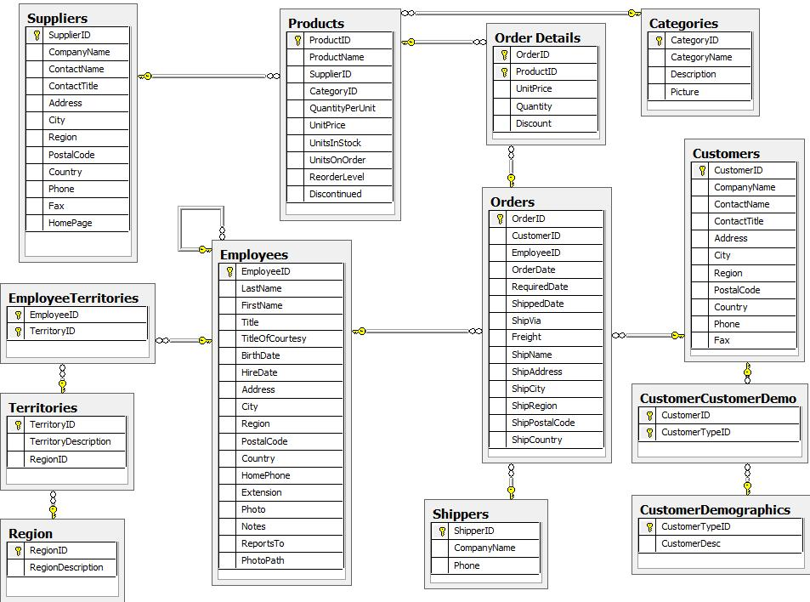
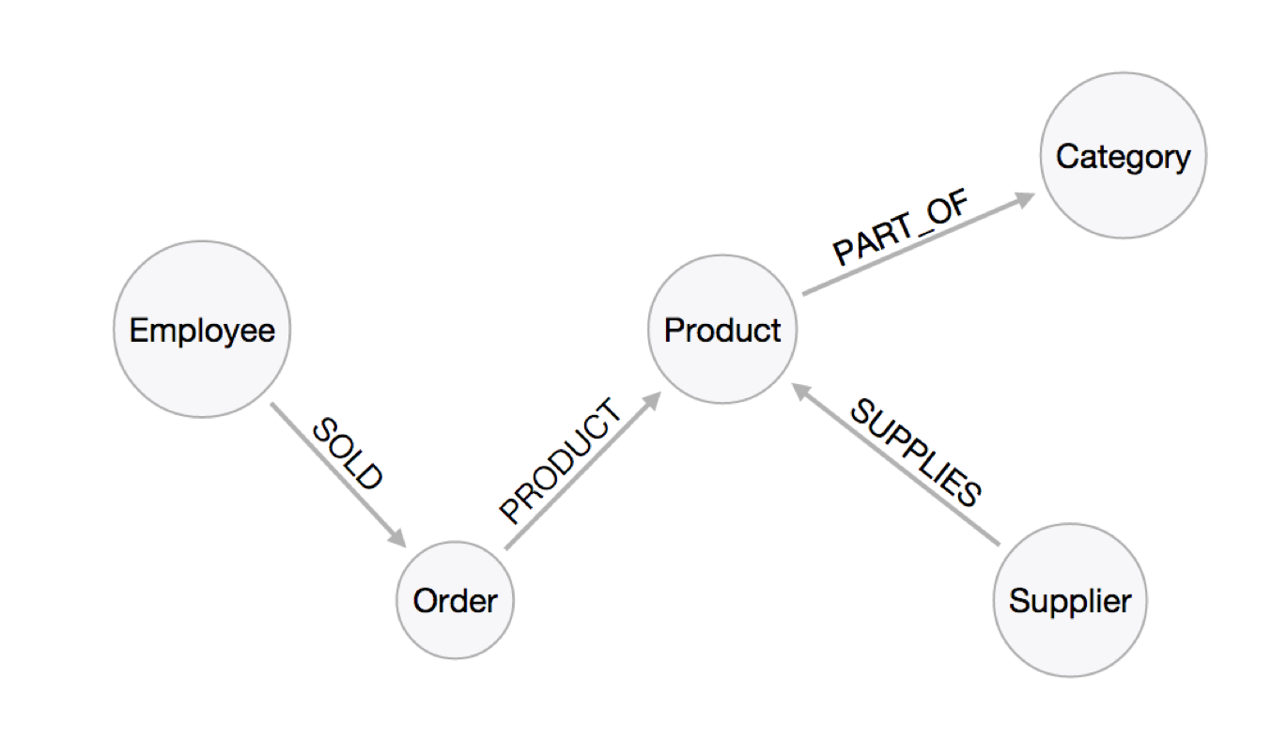
Relational vs Neo4j

Slide 6
Why Use Graph Databases?
It not only stores the data but also stores the relationships between the data.
It is a great medium for quickly analyzing data
Since the nodes are interconnected, you can easily traverse through millions of nodes in a short span of time while also reducing access time
Flexibility and Scalability
Easy to query(navigation)
Simple data model
Notes:
Now, you all must be thinking about why do we require such database when a normal one can also do the same function. So, the answer is here- It not only stores the data but also the relationships among different data. It is a great medium to have your data analyzed. Since the nodes are interconnected, you can easily traverse through millions of nodes in short span of time and access time will also be less.

Slide 7
Why Not Graph Databases?
True sharding is not yet available
Unable to perform mass analytics queries across all relationships and records
Security concerns with open source graph database technologies
Not optimized for large-volume analytics

Slide 8
Graph Database: Properties
Nodes: the entities in the graph database.
Carry some attributes with them, these attributes are known as the
Relationships: the direction arrows or the connections between the nodes that show the relation between the nodes.
Also known as a weighted graph or directed graph.
Notes:
There are some properties with which such graphs come and these are: Nodes: they are the entities in the graph database. They carry some attributes with them, these attributes are known as the properties of the graph databases. Relationships: these are the directed arrows or the connections between the nodes that show the relation among the nodes. Due to this reason, the graph is also known as weighted graph or directed graph.

Slide 9
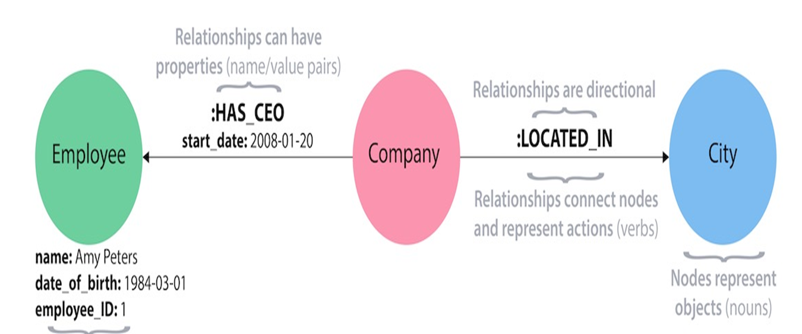
Graph Database: Example
Notes:
This is a simple representation of how the graph database works. It is showing the entities or the nodes are the circles and the relationship between them which is represented by the arrow for showing the direction.

Slide 10
Neo4j
An open source NO SQL database
Complies with ACID database properties
Initial development started in 2003 and made publicly available in 2007
Java and Scala are main source code languages
Easy to learn and easy to use
Largest and most active graph community on the planet
Notes:
NEO4J is one such database. It is an open source NO SQL database. It complies with ACID properties of a database. ACID means atomicity, consistent, integrity and data holding capacity is high. Its initial development started in 2003 and then it was made publically available in 2007. Java and Scala are the languages in which its source code is written and readily available in the github as an open source code.

Slide 11
Neo4j (cont.)
Since it is an open source, it is freely available through GitHub
It has both Community and Enterprise Editions
Enterprise edition offers extra features such as clustering, backups and other fail-over techniques
Uses pointers to traverse down the nodes

Slide 12
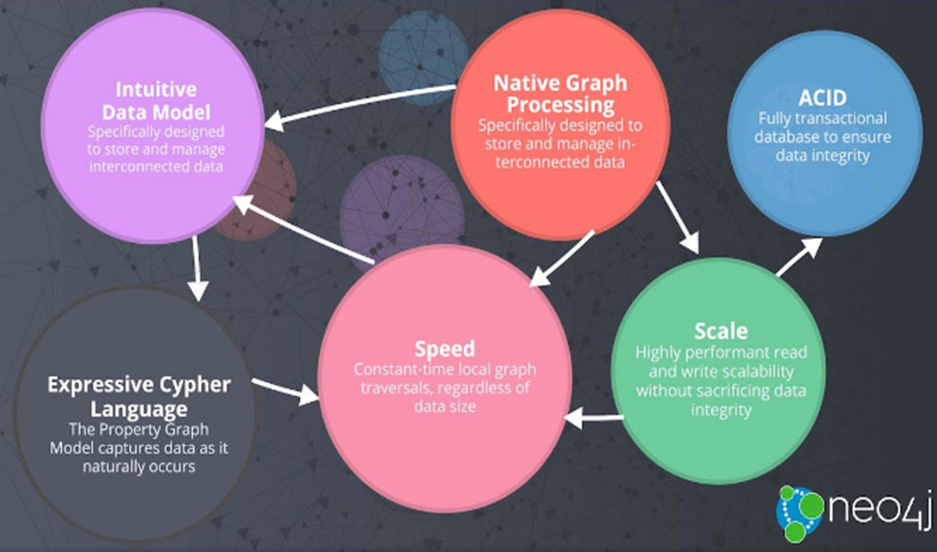
Neo4j: Pictorial Representation
Notes:
the figure above shows that all the features of graph databse neo4j are interlinked. each one contribute to the functioning of one another. Like cypher language is an easy language due to whuch it process the data query faster and hence increasing the speed.

Slide 13
Neo4j: Features
Cypher –a language for declarative query, mainly used in graph databases
Time intervals – helps the user to drill down or scale up within the billions of nodes in much quicker time frame
Flexible – a property of the graph schema that can adapt with time. It helps in making new relationships and speeds up the traversing path.
Notes:
There are certain features of neo4j much similar to the graph database and they are: Cypher – it is a language for declarative query, mainly used for graph databases. Time intervals – it helps the user to drill down or scale up within the billions of node in a less span of time. Flexible – it is a property of graph schema that can adapts with time. It helps in making new relationships and speed up the traversing path.

Slide 14
Neo4j: Managing a Complex Network using Real Time Insights
All the complex configuration of the network is stored in CMDB (configuration management database).
These are relational databases using Neo4j.
It helps you connect to the monitoring tools and view the insights of complex relationships between different network devices and the data center.

Slide 15
Neo4j: Master Data Management
Neo4j enables a 360-degree view of the data available in the real time system.
Allowing it to provide more insight and be more understandable.
It is capable enough to use for activities ranging from ecommerce to customer support.
All the master data is either stored in a single repo or the shared repo.

Slide 16
Neo4j: Use Cases
Neo4j is currently used by thousands of organizations and companies.
It includes numerous sectors including
Fraud Detection
Network and IT Operations
Social Networks
Retail
Machine Learning
The technology is constantly evolving to help improve the products

Slide 17
Neo4j: Fraud Detection
Augments discrete data scrutiny with data relationship analysis
Real-time traversal of complex and highly interconnected data sets
Stores interconnected data that is neither purely linear or hierarchical
Versatile properties allowing for easier evolution of fraud detection models

Slide 18
Neo4j: Networks and IT Operatoins
Quickly determine impacts of node failure, maintenance outage or incursion
Quick and easy to trace back dependencies to identify the root cause of problem
Easy routing and QoS mapping to find best, shortest or least-busy path for a new service

Slide 19
Neo4j: Retail
Decipher suggestion data easier with the native graph storage architecture
Evolve real-time recommendation engines easily
Allows for real-time decision making using high-performance graph queries
Data is always available to the mission-critical recommendation engine

Slide 20
Neo4j: Social Media
Social media networks are already formatted as graphs
There’s no need to be converted into tables and then back into graphs
We all know social media has a huge amount of data stored in its database and every second a new connection is added.
Using Neo4jhelps reduce the time to traverse among the nodes and will improve the quality.
Notes:
(looking at the use cases), you can very well figure out how indispensible such a graph is for many industries. I am looking forward to deliver more such presentations. Thank you for being an interactive audience.

Slide 21
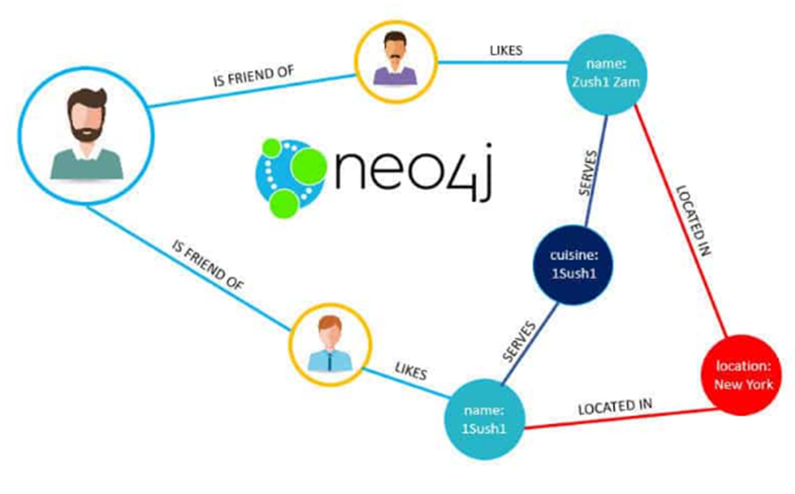
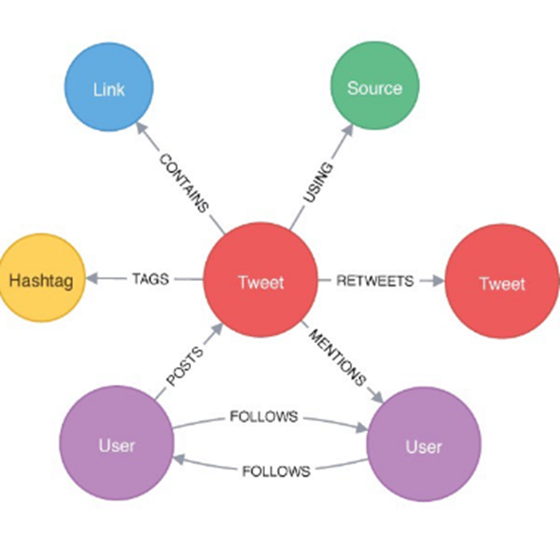
The Picture Speaks for Itself….

Slide 22
References:
Angles, R., & Gutierrez, C. (2008). Survey of graph database models. ACM Computing Surveys (CSUR), 40(1), 1.
Robinson, I., Webber, J., & Eifrem, E. (2013). Graph databases. " O'Reilly Media, Inc.".
Bollacker, K., Evans, C., Paritosh, P., Sturge, T., & Taylor, J. (2008, June). Freebase: a collaboratively created graph database for structuring human knowledge. In Proceedings of the 2008 ACM SIGMOD international conference on Management of data (pp. 1247-1250). AcM.

